Slide 1
Algebra

Slide 2
Sum of internal angles in a triangle =
180°

Slide 3
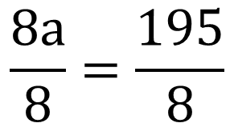
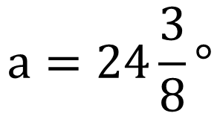
3a + 4a – 35 + a + 20 = 180
8a – 15 = 180
8a – 15 + 15 = 180 + 15
8a = 195
$$\frac{8a}{8}=\frac{195}{8}$$
$$a=24\frac{3}{8}°$$

Slide 5
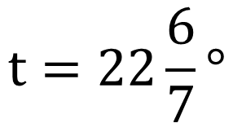
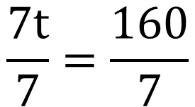
3t + t + 20 + 3t= 180
7t + 20 = 180
7t + 20 - 20= 180 - 20
7t = 160
$$\frac{7t}{7}=\frac{160}{7}$$
$$t=22\frac{6}{7}°$$

Slide 6
Remember that a quadrilateral has internal angles totalling 360°.

Slide 7
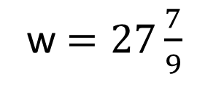
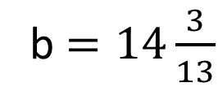
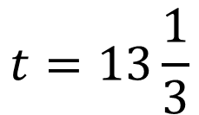
$$t=13\frac{1}{3}$$
b $=14\frac{3}{13}$
w $=27\frac{7}{9}$
Remember that a quadrilateral has internal angles totalling 360°.

Slide 8
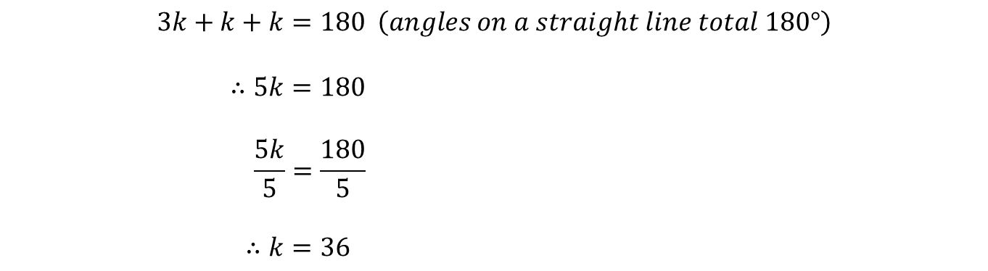
ABC is a straight line. Calculate the size of k.
$$3k+k+k=180 \left(angles on a straight line total 180°\right)$$
$$∴5k=180$$
$$\frac{5k}{5}=\frac{180}{5}$$
$$∴k=36$$

Slide 9
For each of these questions, ABC is a straight line. Calculate the size of t.
1
2
3
4

Slide 10
For each of these questions, ABC is a straight line. Calculate the size of t.
1
2
t = 20
t = 40
3
4
t = 30
t = 22½

